Slide 1

Predicting the Best Location for Restaurants in North York Toronto

Slide 2
Project Purpose
Find
Benefit
Benefit entities who wants to start a new restaurant in North York Toronto.
Benefit
Benefit investor who are looking for the area in North York where restaurants are the most popular venue choice.
Find the most popular neighbourhoods in North York to establish a new restaurant.

Slide 3

Data acquisition
Toronto post code, borough and neighbourhood data
Venue details are provided by Foursquare
Geospatial co-ordinate

Slide 4
Data cleaning
Handle missing data
01
Consolidate data frames
02
Feature engineering
03

Slide 5
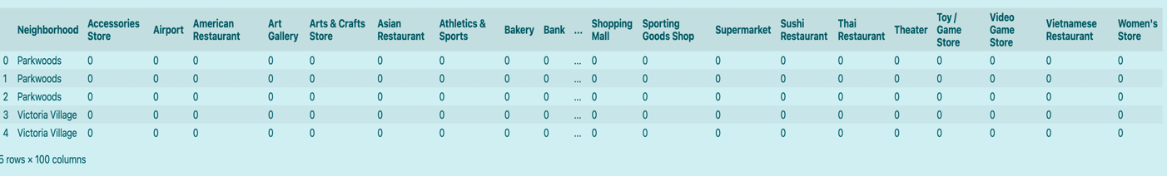
Exploratory Data Analysis

Slide 6

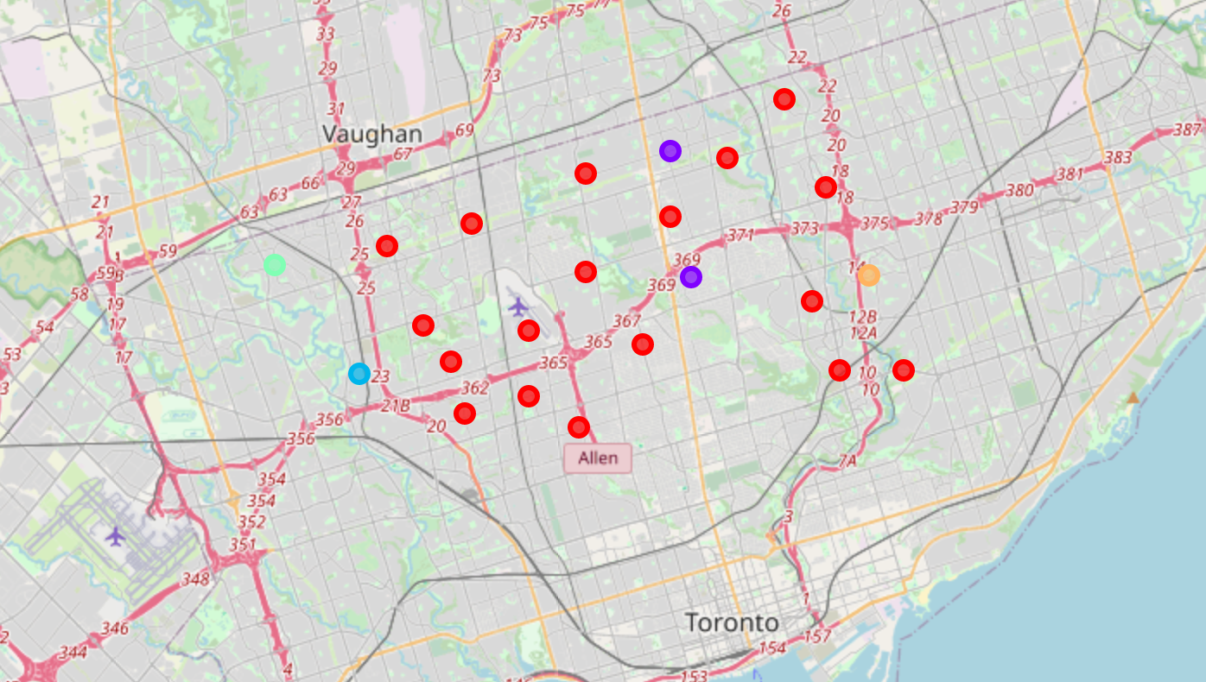
Predictive Modelling
model outcome

Slide 7


Thank you!

